Slide 1

Build software like sean combs
Part 2
Commands, Queries, and Notifications

Slide 2
Part 1 - How to Build a Better Domain Model
Part 2 – Commands, Queries, and Notifications
Part 3 - Use Unit Tests and Containers Like A Boss
Part 4 - Designing a Refactor-Proof Architecture

Slide 3
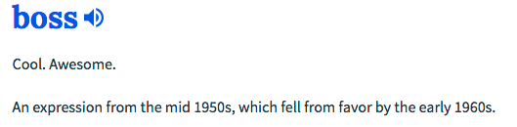

Slide 5
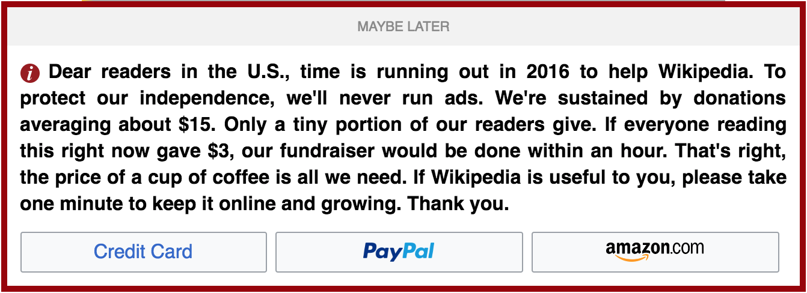
references

Slide 6


Slide 7
LAST TIME on BUILD software like Sean combs
How To Build A Better Domain Model

Slide 8
Our domain
Expression
Result
2 + 2 - 1 = 3
Math Equation

Slide 10
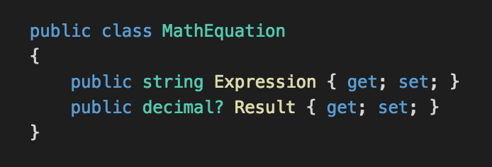

Slide 11

anemic domain model
The use of a software domain model where the domain objects contain little or no business logic (validations, calculations, business rules etc.).

Slide 12
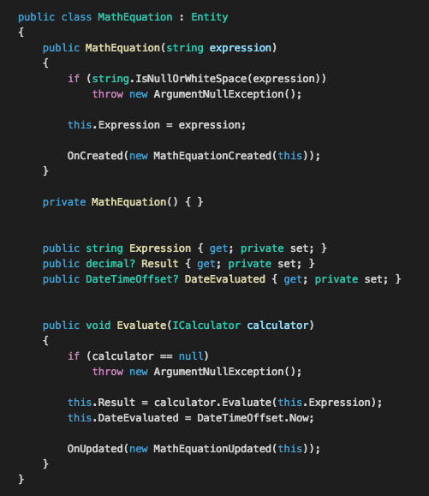

Slide 14
anemic domain model
The use of a software domain model where the domain objects contain little or no business logic (validations, calculations, business rules etc.).

Slide 15

anemic domain model
The use of a software domain model where the domain objects contain little or no business logic (validations, calculations, business rules etc.).

Slide 16

Design patterns are recommendations.

Slide 17
TODAY on BUILD software like Sean combs
Commands, queries and notifications

Slide 18


Slide 19
anemic domain model
Logic cannot be implemented in a truly object-oriented way.
Violation of the encapsulation and information hiding principles.

Slide 20
anemic domain model
Needs a separate business layer to contain the logic otherwise located in a domain model. It also means that domain model's objects cannot guarantee their correctness at any moment, because their validation and mutation logic is placed somewhere outside (most likely in multiple places).
Makes a model less expressive.

Slide 21


Slide 22
COMMANDS

Slide 23
Console App
2+2
WebAPI App
4
Domain Model
Domain Model

Slide 24
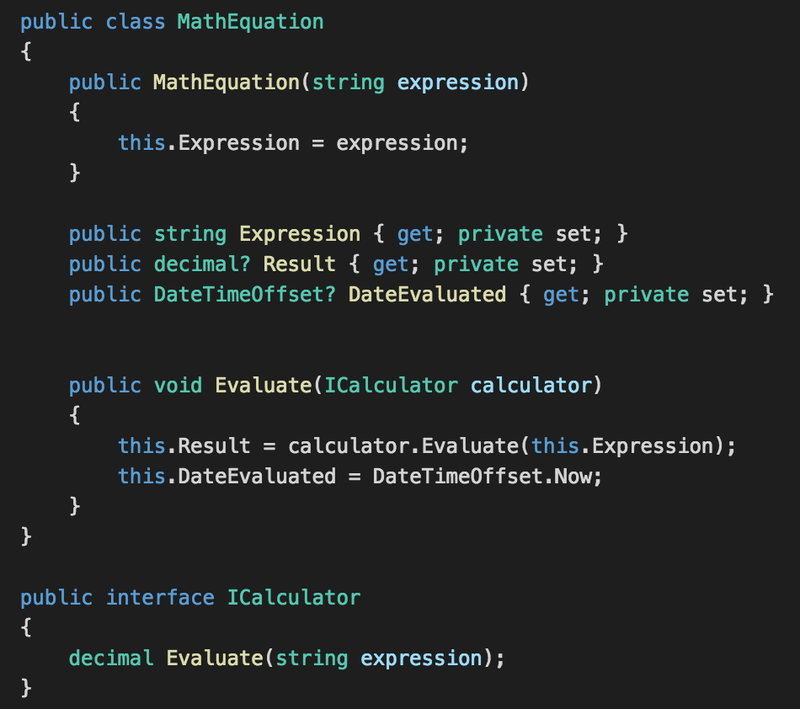

Slide 26
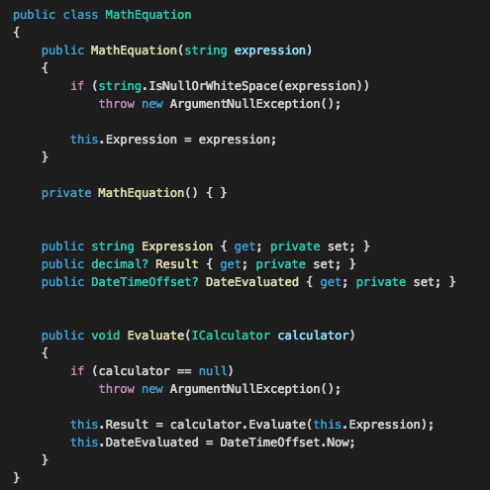

Slide 27

“COMMAND” Pattern
CQRS
GOF

Slide 28
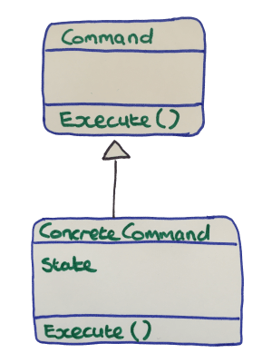
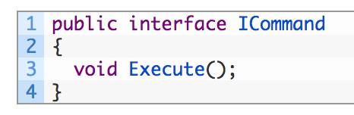
Command Pattern
GOF Implementation

Slide 29
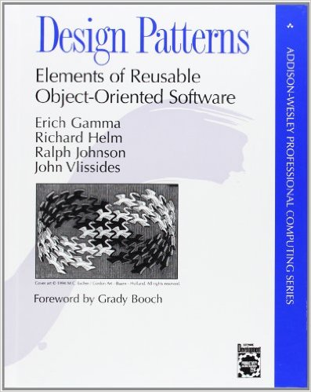

Slide 30
Command Pattern
CQRS Implementation
State or Criteria
Handler
Result

Slide 31
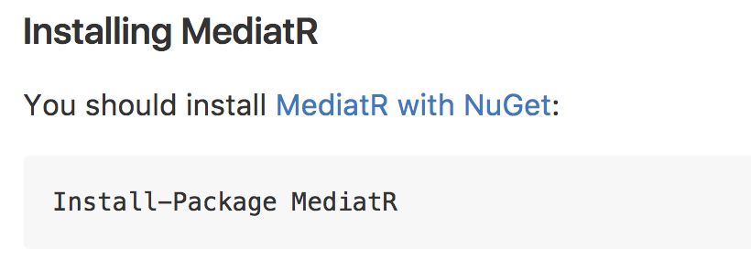

Slide 32
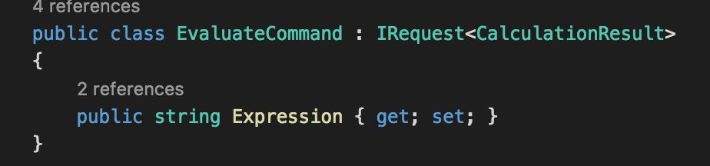

Slide 33
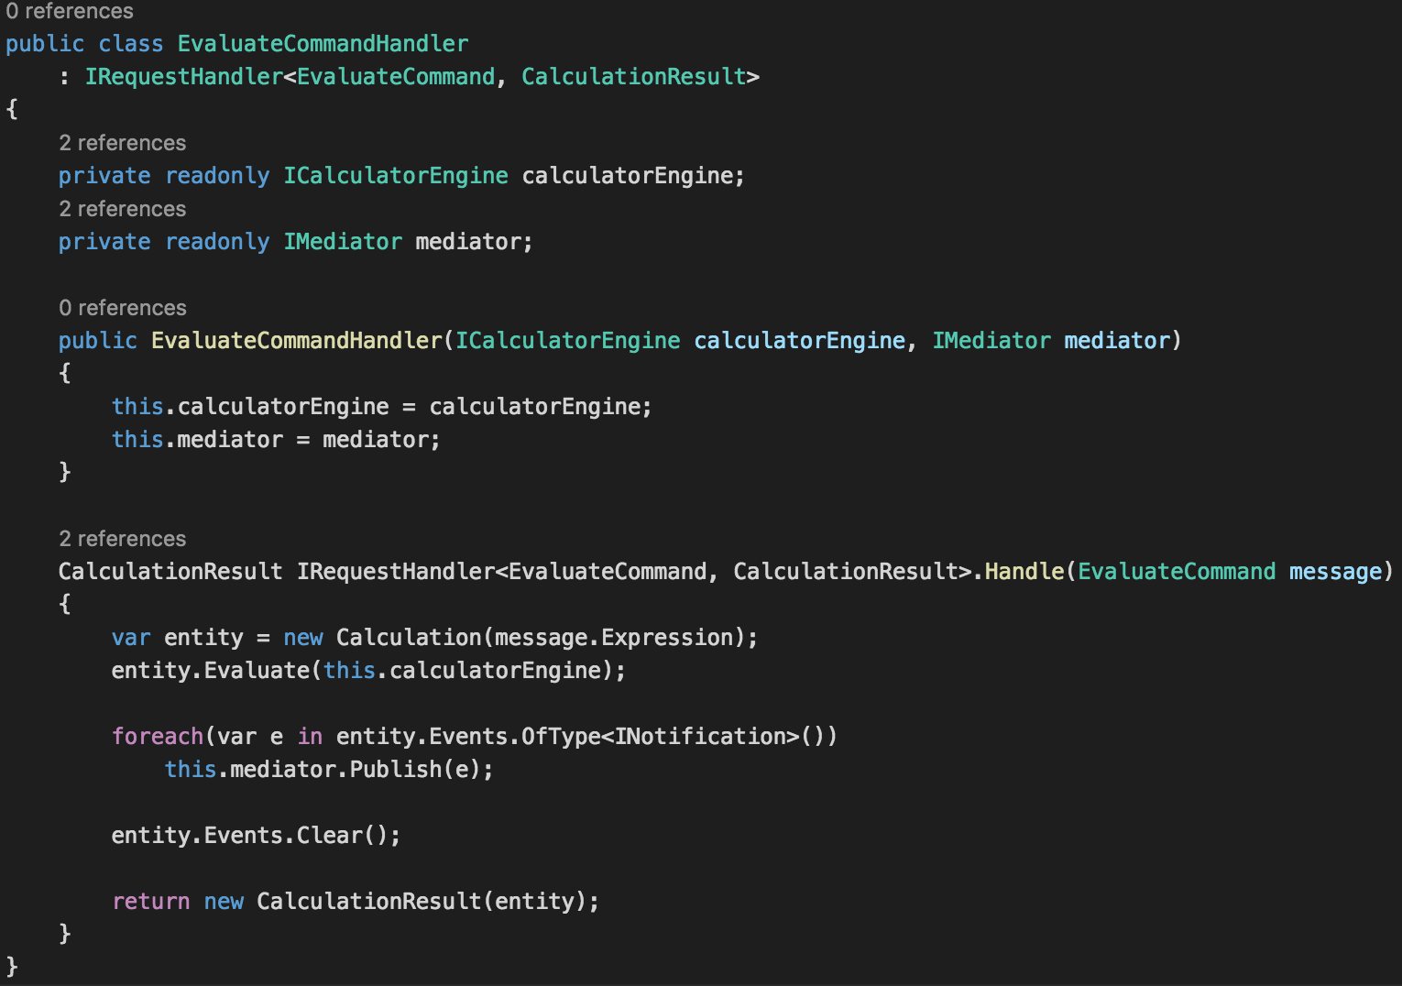

Slide 35
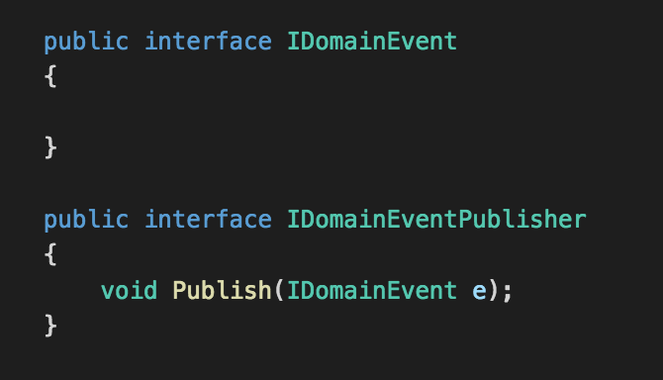

Slide 36
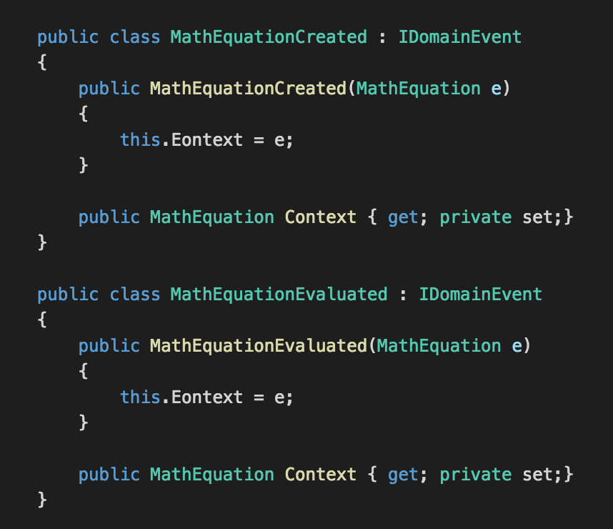

Slide 38
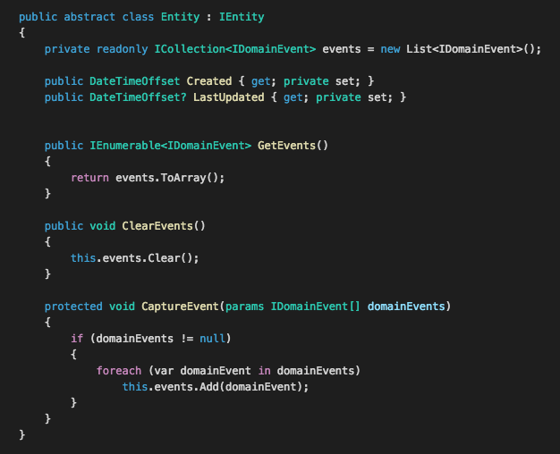

Slide 39
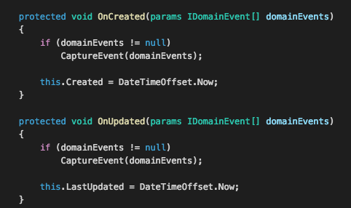

Slide 40
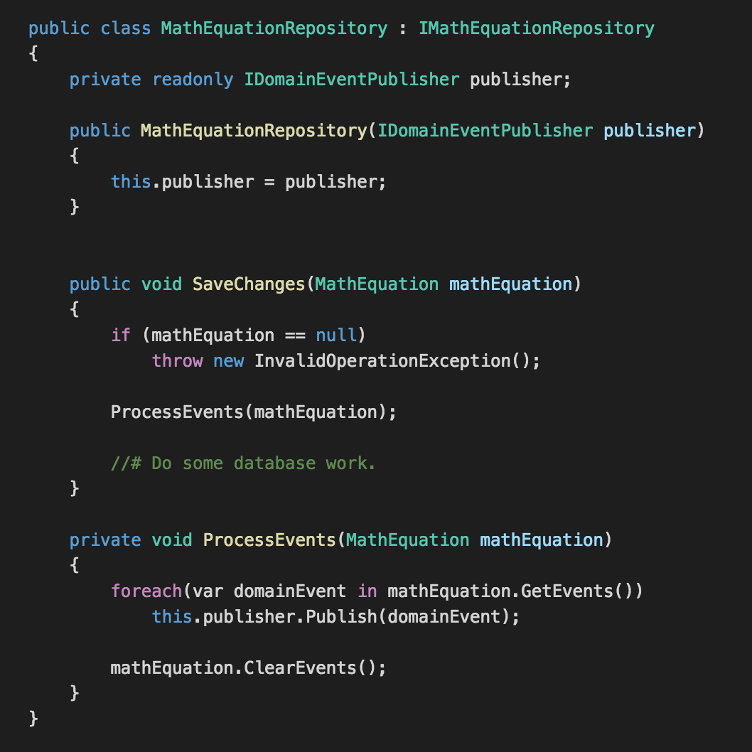

Slide 42
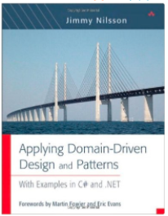
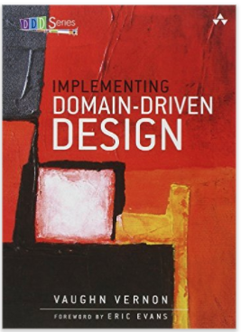
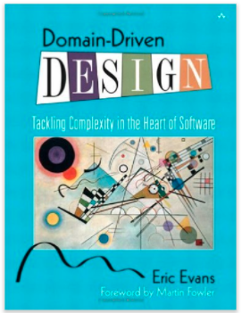
Resources

Slide 43
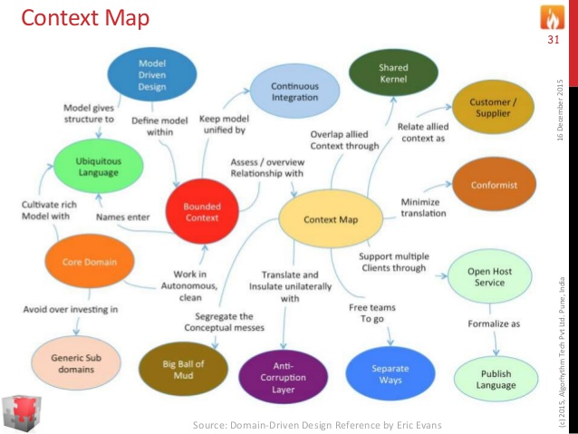

Slide 44
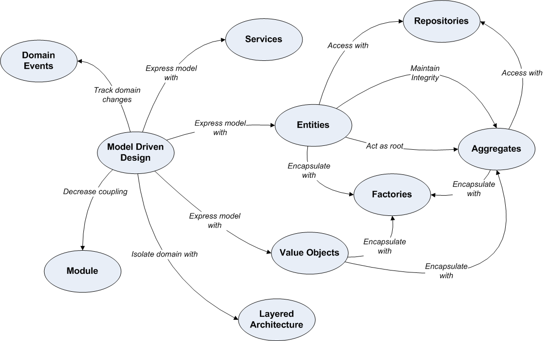

Slide 45
Domain Model
User Interface
Request Middleware

Slide 46
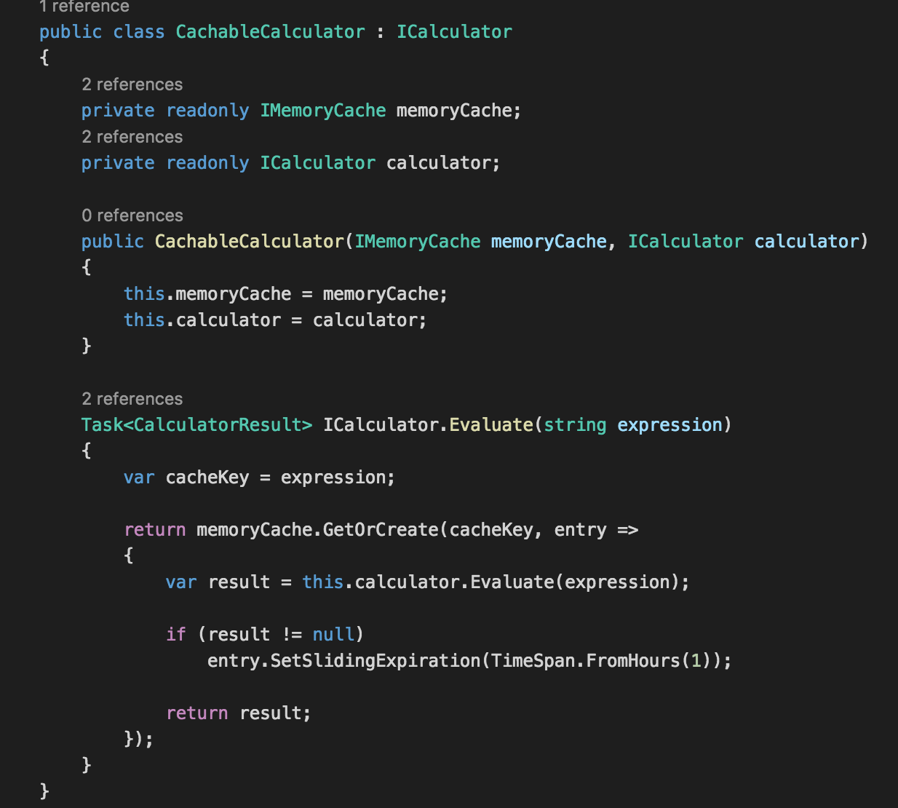

Slide 48
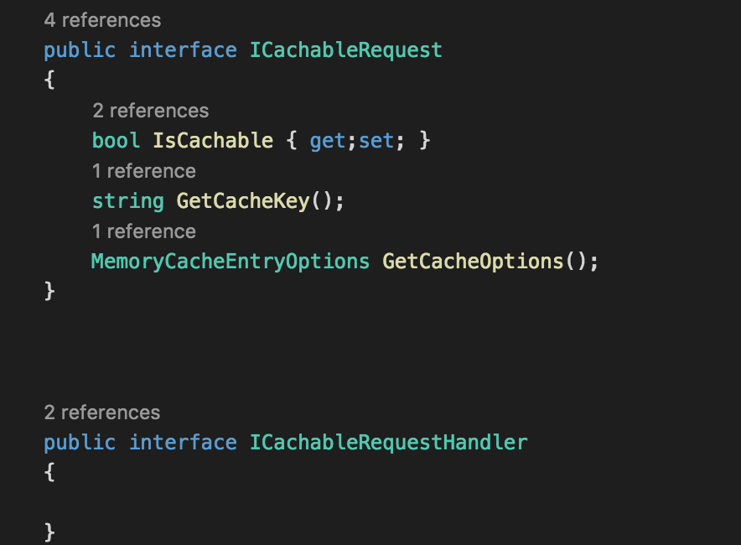

Slide 49
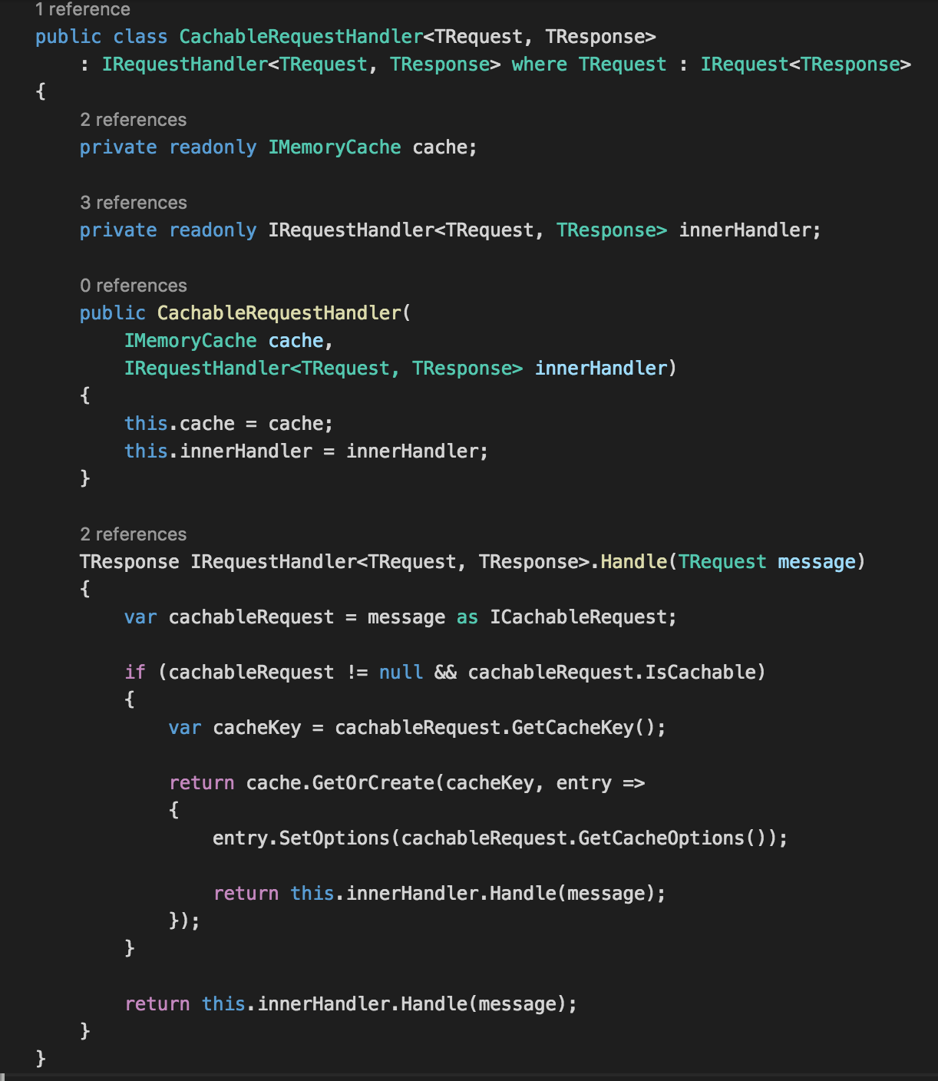

Slide 52
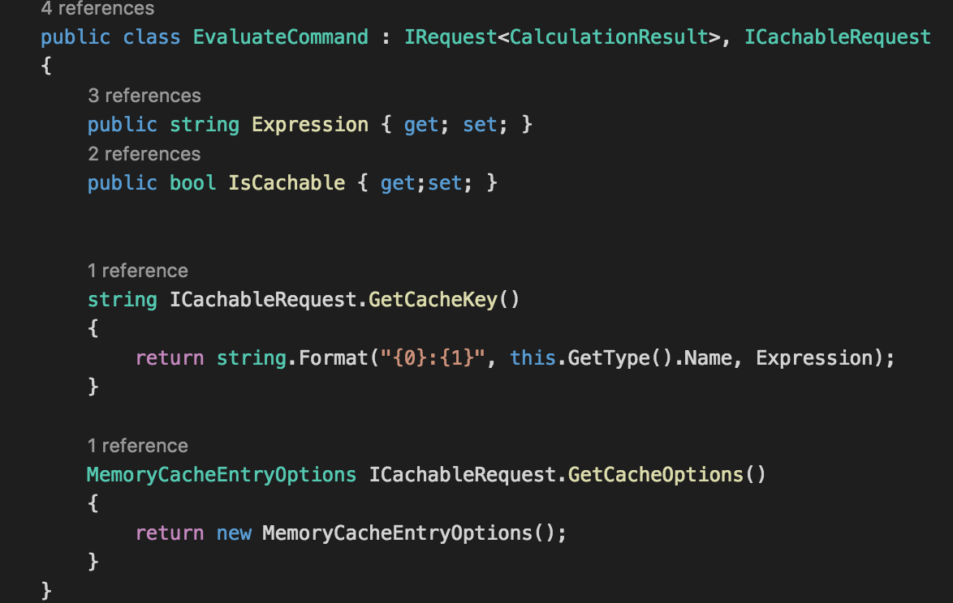

Slide 53
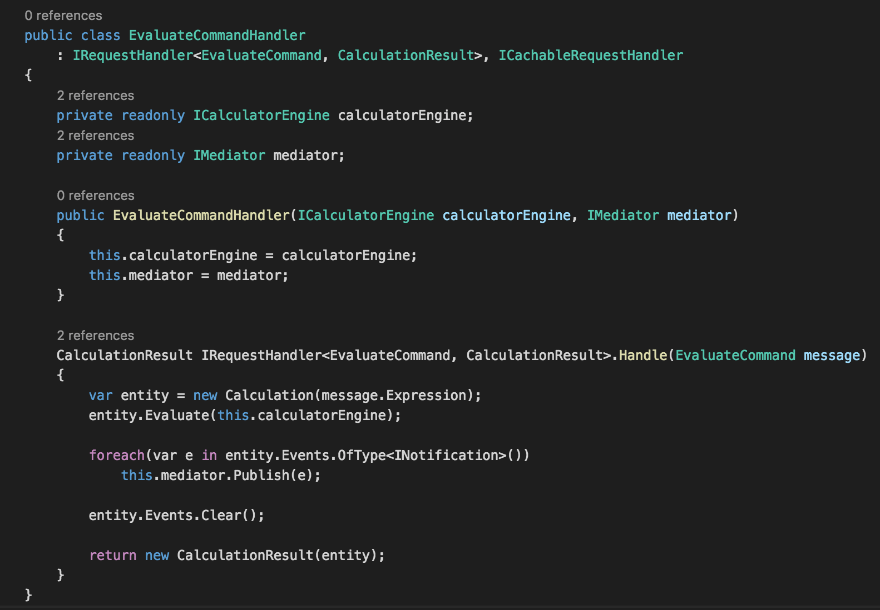

Slide 54
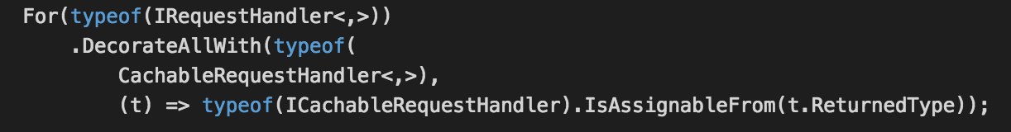

Slide 55

Source code
https://github.com/neekgreen/calculator

Slide 56
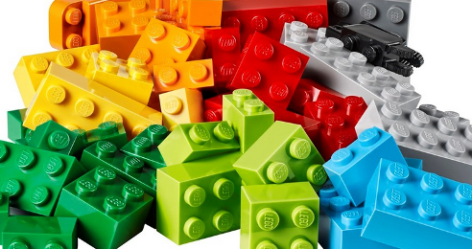
DEMO

